Slide 1

First Tennessee Area Agency on Aging and Disability
PUBLIC HEARING
FOUR-YEAR AREA PLAN
(July 1, 2026–June 30, 2029)
Notes:
Welcome! Thank you for being here. On behalf of FTAAAD, I am pleased to present the proposed Four-Year Area Plan covering July 1, 2026-June 30, 2029. We have a couple of printed copies available today or you can access the plan through our website, ftaaad.org. There is a slide with this information at the end of my presentation.

Slide 2
First Tennessee Area Agency on Aging and Disability
Our mission is to assist older individuals and adults with disabilities in Northeast TN with information and services that promote quality of life and independence.
Serving Carter, Greene, Hancock, Hawkins, Johnson, Sullivan, Unicoi and Washington Counties
Notes:
At the First TN Area Agency on Aging and Disability, our mission is to assist older adults and adults with physical disabilities with information and services that promote quality of life and independence. We serve the upper 8 counties of East TN and act as as the central hub for addressing aging issues across our region.

Slide 3
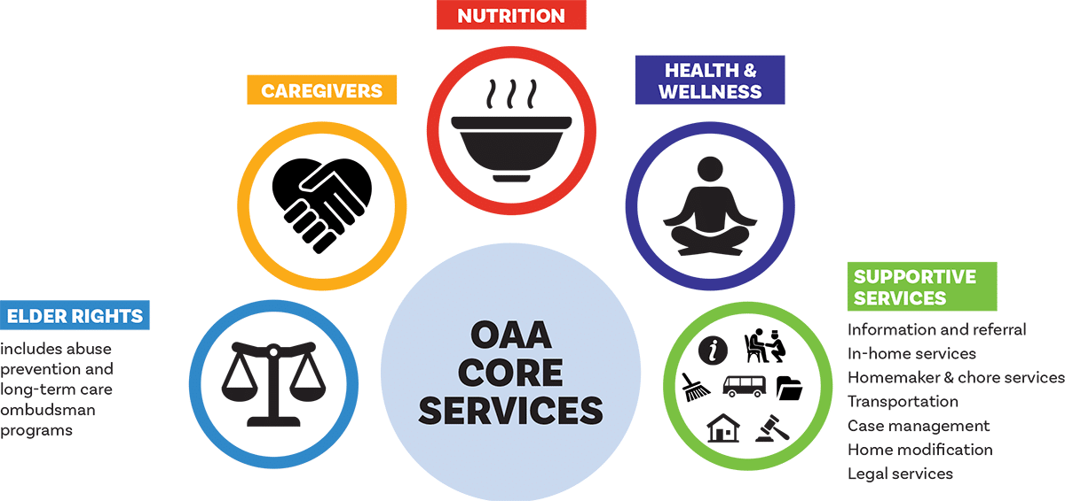
What is the Older Americans Act (OAA)?
Congress passed the Older Americans Act (OAA) in 1965 in response to concern by policymakers about a lack of community social services for older persons.
The original legislation established authority for grants to states:
    community planning and social services
    research and development projects
    personnel training in the field of aging
Although older individuals may receive services under many other federal programs, today the OAA is the major vehicle for the delivery of social and nutrition services to this group and their caregivers.
It authorizes a wide array of service programs through a national network of 56 state agencies on aging, 618 area agencies on aging, nearly 20,000 service providers.
Notes:
The Older Americans Act of 1965 created the national aging network and provides the primary federal support for services that help adults 60 and older live independently. It established federal and state agencies on aging, including Tennessee’s State Unit on Aging (Department of Disability and Aging Services), and directs funding to local communities. Over the years, it has expanded to include caregiver support, elder justice, dementia programs, and home‑ and community‑based services.

Slide 4
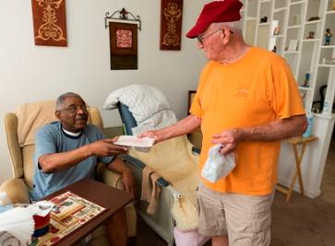

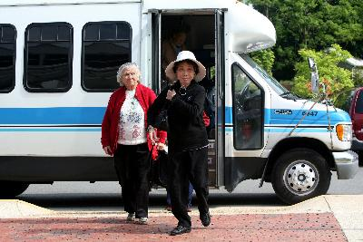
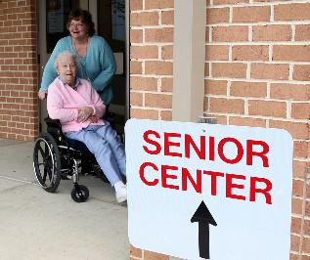
What are Area Agencies on Aging (AAAs)?
An area agency on aging (AAA) is a public or private nonprofit agency designated by a state to address the needs and concerns of all older persons at the regional and local levels. AAA is a general term — names of local AAAs may vary.
AAAs are primarily responsible for a geographic area, also known as a planning and service area (PSA).
AAAs coordinate and offer services that help older adults remain in their homes, if that is their preference, aided by services such as home-delivered meals, homemaker assistance, and whatever else it may take to make independent living a viable option. By making a range of supports available, AAAs make it possible for older individuals to choose the services and living arrangements that suit them best.
Notes:
Area Agencies on Aging are nonprofit or public agencies designated by each state to address the needs of older adults at the regional and local levels. First Tennessee Area Agency on Aging and Disability is one of nine in Tennessee and part of a nationwide network of 618 agencies.
Guided by the Older Americans Act, we coordinate services, advocate for older adults, and support community systems that help seniors and caregivers live independently. We also administer federal and state Home and Community‑Based Services for older adults, caregivers, and individuals with physical disabilities.

Slide 5
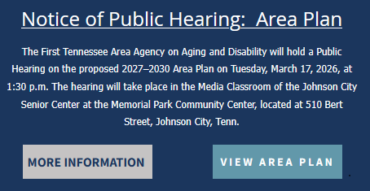
What is an Area Plan?
The Older Americans Act requires the creation of an “Area Plan on Aging and Disability” for the region every four years. FTAAAD is responsible for creating the Area Plan to reflect the statewide goals set forth by DDA and is primarily related to programs and services funded by that agency. Our Area Plan addresses how the organization will deploy DDA-funded resources, and as such, is restricted to activities allowed by those funding sources.
The current Area Plan was adopted by FTAAAD in March 2023. The plan identified regional goals, program priorities, and funding sources for programs and services offered between July 1, 2023 and June 30, 2026. The plan was made available to members of the general public, local and state-elected officials, and partner agencies and organizations for review and comment prior to its adoption.
This public hearing is to address the major four-year update to the FTAAAD Area Plan which will reflect activities between July 1, 2026 and June 30, 2029.
Notes:
So what is an Area Plan?
The Older Americans Act requires each region to develop a four‑year Area Plan.
Our Current Plan
was adopted in March 2023, and outlines priorities and funding for July 2023–June 2026.
Purpose of Today’s Public Hearing
Gather community input to help shape the upcoming FTAAAD Area Plan
Ensure local needs, priorities, and concerns are reflected in the 2026–2029 plan
Provide transparency about goals, programs, and funding decisions

Slide 6


Area Plan Objectives (State & Local)
The four-year Area Plan features goals developed at the state level by the DDA for all Tennessee AAAs.
Individual objectives within these goals are developed locally by each AAA.
FTAAAD’s local objectives are based on research and feedback from:
  The State Multi-Sector Plan on Aging
  National, statewide, regional and local statistics on aging, income and demographics
  Surveys of Need from:
    Senior Center Directors
    FTAAAD Advisory Council
    FTAAAD Staff
FTAAAD’s locally-based objectives combine the state focus on particular areas of need with our knowledge and feedback from our local communities.
Notes:
FTAAAD prepares this plan to align with statewide goals and guide how Department of Disability and Aging funded programs and services are delivered.
We established our objectives based on research and feedback from multiple sources.

Slide 7
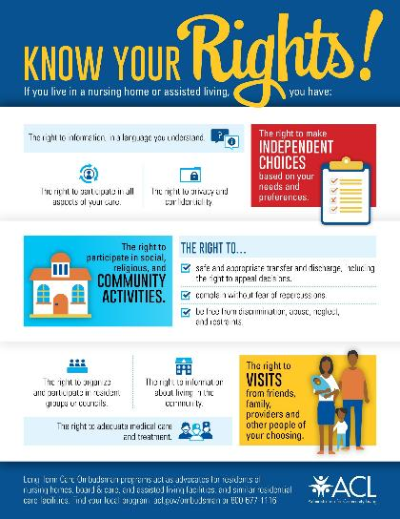


Waivers Requested
Ombudsman Services
Case Management
National Family Caregiver Support Program
Notes:
Three waivers are being requested for Direct Service Delivery. They include:
Ombudsman Services
Case Management
National Family Caregiver Support Program

Slide 8
Proposed Goals and Objectives
PROGRAM DEVELOPMENT AND COORDINATION
Goal: To strengthen and expand programs and partnerships that improve the quality of life, independence, and well-being of older adults in Northeast Tennessee through effective program development and coordination.
Objective One—Enhance Training and Professional Development
Objective Two—Strengthen Senior Centers as a Focal Point in the Community
Notes:
For program development and coordination, our goal is to Strengthen Programs and Partnerships by
Enhancing Training and Professional Development​
​
Strengthening Senior Centers as a Focal Point in the Community​

Slide 9
Proposed Goals and Objectives
PROGRAM DEVELOPMENT AND COORDINATION, continued
Goal: To strengthen and expand programs and partnerships that improve the quality of life, independence, and well-being of older adults in Northeast Tennessee through effective program development and coordination.
Objective Three—Improve Communication and Collaboration Among Aging Networks
Objective Four—Increase Public Awareness of Aging Services
Notes:
Improving Communication ​
​
Increasing Public Awareness of Services ​AND

Slide 10
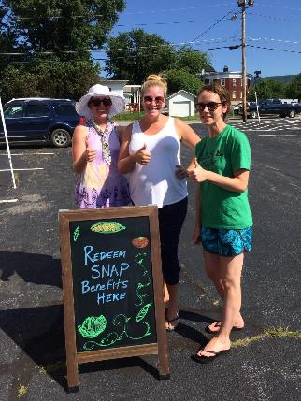
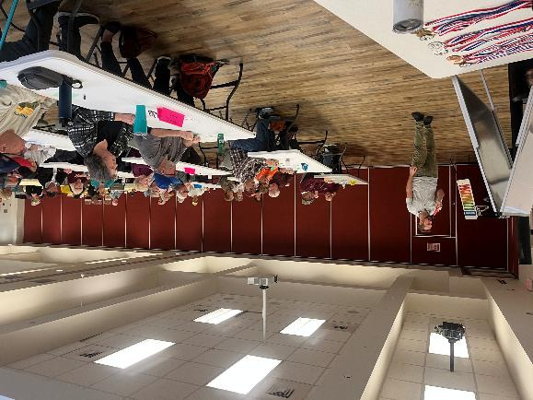

Proposed Goals and Objectives
PROGRAM DEVELOPMENT AND COORDINATION, continued
Goal: To strengthen and expand programs and partnerships that improve the quality of life, independence, and well-being of older adults in Northeast Tennessee through effective program development and coordination.
Objective Five—Expand Funding Opportunities
Notes:
Expanding Funding Opportunities

Slide 11
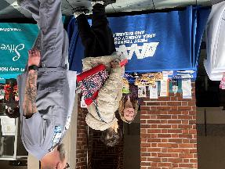
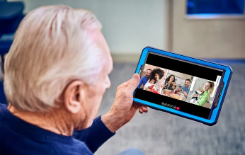
Proposed Goals and Objectives
ADDITIONAL GOALS AND OBJECTIVES
Goal 1: Access, Community Choice, and Aging in Place. Make sure older adults and adults with disabilities in the First Tennessee region can get the services they need. These services should support independence, safety, dignity, and a good quality of life.
Objective One—Identify and disseminate information on the types of available community-based assistance that are most needed by Northeast Tennessee’s low-income and rural demographic.
Objective Two—Explore technological options and advancements to improve service delivery and access to enabling technologies for aging in place.
Notes:
Additional Goals and Objectives include:
Access, Choice, Aging in Place
Focusing on supporting independence, safety, dignity, and a good quality of life​
Key objectives are to
Identify community‑based services most needed in Northeast Tennessee and Share that information with low‑income and rural residents
Explore new technologies to improve service delivery and expand access to tools that support aging in place

Slide 12
Proposed Goals and Objectives
Goal 2: Funding, Advocacy, and Infrastructure. Build and maintain strong services by using funds wisely, finding new funding, working with partners, remaining flexible for complex needs, and speaking up for the people we serve.
Objective One—Investigate opportunities for individuals, colleges, businesses, or other community organizations to donate directly and/or develop/host fundraising events on behalf of FTAAAD.
Objective Two—Expand relationship-building with both current partners and other agencies and state departments/legislators to break down silos and to increase funding potential.
Notes:
Goal 2: Funding, Advocacy, and Infrastructure
Key Points:
Use funds wisely and pursue new funding, Strengthen services through strong partnerships, Stay flexible to meet complex needs, and Advocate for the people we serve
Objectives:
To Explore opportunities for direct donations and Identify partners to support or host fundraising events
Strengthen relationships with current partners, build connections, and reduce silos expanding funding opportunities AND

Slide 13
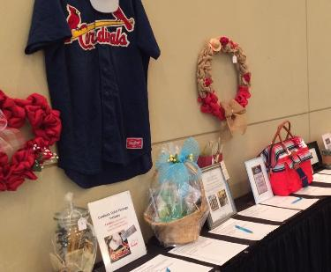
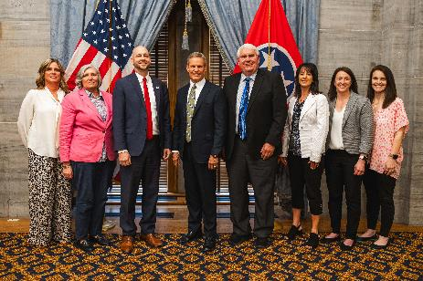
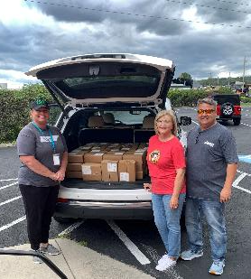
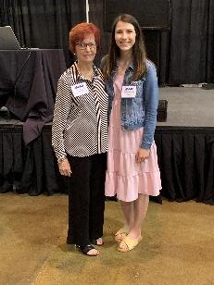
Proposed Goals and Objectives
Goal 2: Funding, Advocacy, and Infrastructure, continued. Build and maintain strong services by using funds wisely, finding new funding, working with partners, remaining flexible for complex needs, and speaking up for the people we serve.
Objective Three—Strengthen FTAAAD’s internal framework through workforce training and development, prioritizing the use of volunteers and interns, expanding crisis and emergency planning, and ensuring that public feedback is continually sought and incorporated into agency procedures as appropriate.
Notes:
Other key elements:
Strengthen workforce through training and development
Expand use of volunteers and interns
Enhance crisis and emergency planning
Incorporate public feedback into agency processes

Slide 14
Proposed Goals and Objectives
Goal 3: Health, Healthcare, and Well-being. Help people stay healthy, feel supported, and enjoy life through prevention, access to care, independence, and overall wellbeing.
Objective One—Promote healthy aging through good nutrition, management of chronic conditions and mental health, personal safety and a focus on overall wellness.
Objective Two—Improve access to health resources.
Notes:
Goal 3: Health, Healthcare, and Well-Being
Help people stay healthy, supported, and independent through prevention, care access, and overall wellbeing.
Key objectives:
Promote healthy aging through good nutrition, management of chronic and mental health conditions, and encouraging personal safety and overall wellness
WE also want to Improve access to health resources AND

Slide 15
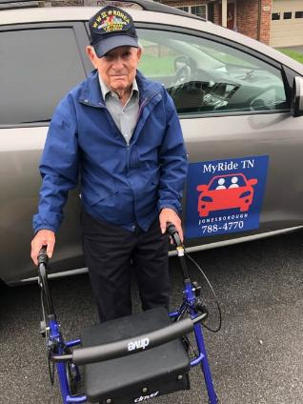
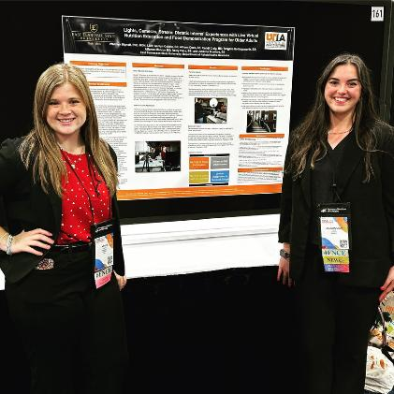
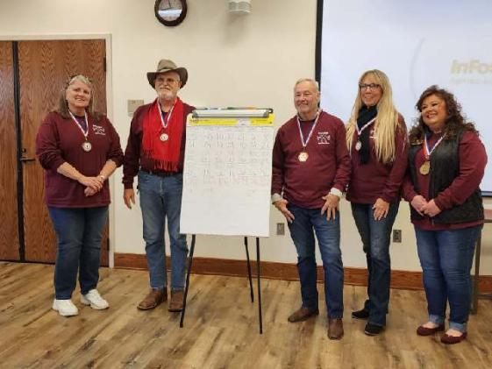
Proposed Goals and Objectives
Goal 3: Health, Healthcare, and Well-being, continued. Help people stay healthy, feel supported, and enjoy life through prevention, access to care, independence, and overall wellbeing.
Objective Three—Increase social connection among older adults.
Notes:
Objective 3: Increase social connection

Slide 16
Proposed Goals and Objectives
Goal 4: Caregiver Support. Make it easier for caregivers to find help and feel supported, with special focus on rural and high-stress caregivers.
Objective One—Expand programs and services offered to caregivers.
Objective Two—Offer enhanced counseling and education opportunities to caregivers.
Notes:
Goal 4: Caregiver Support
Make it easier for caregivers to find support
Key objectives:
Expand programs and services offered
Offer counseling and education opportunities to caregivers AND

Slide 17
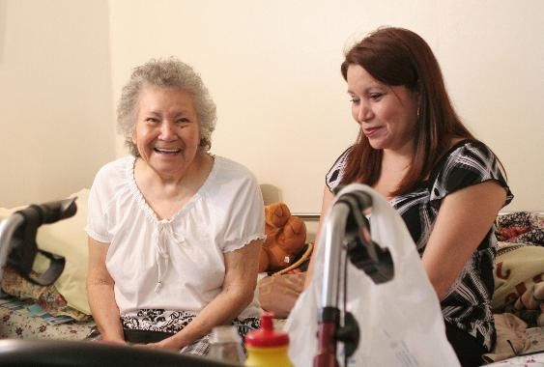
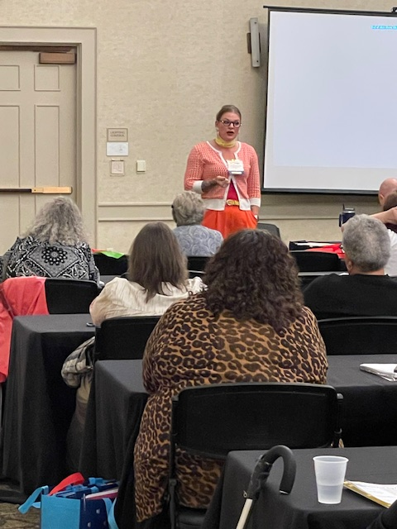
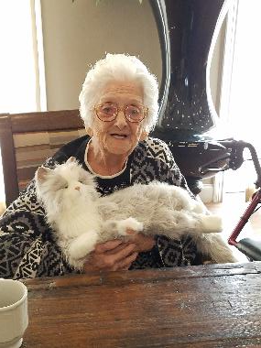
Proposed Goals and Objectives
Goal 4: Caregiver Support, continued. Make it easier for caregivers to find help and feel supported, with special focus on rural and high-stress caregivers.
Objective Three—Offer both family caregivers and provider-employed caregivers additional training opportunities.
Notes:
Offer training for both informal and formal caregivers
Now Alice Peterson, our Fiscal Manager, will talk more about the proposed budget.

Slide 18
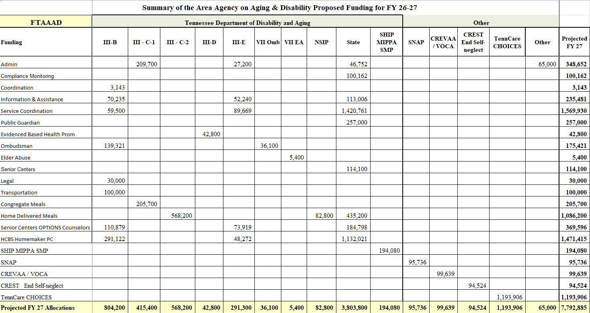
FY26–27 Proposed Budget

Slide 19
Contact FTAAAD
www.ftaaad.org
www.facebook.com/FTAAAD
Information & Assistance Line
423-928-3258
3211 N. Roan St.
Johnson City, TN 37601
Office Hours: Monday–Friday, 8:00am to 4:30 pm
Notes:
I’d like to open the floor for public comments.
Thank you for your interest and participation today.

